Slide 1
Alice and the
.NET Framework
Leif Kornstaedt
Programming Systems Lab
Universität des Saarlandes
PDC 2000

Slide 2

Alice Language Features
Abstraction
Large Systems Dev
Safety
Concurrency
Open Programming

Slide 3


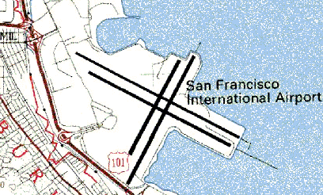
Safety
Polymorphic typing
Strong encapsulation mechanisms
Exception handling
Garbage collection
Abstraction
Higher-order functional language
Uniform overloading & late binding

Slide 4
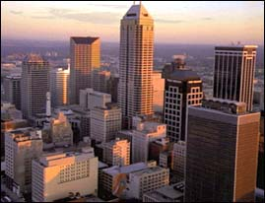


Large Systems
Module system with
higher-order parameterization
Component system for separate
compilation & deployment
Open Programming
Pickling and unpickling via URLs
Interoperability (encapsulated)
Distributed programming

Slide 5


High-Level
Concurrency Model
Light-weight thread creation
Combine building blocks into
high-level concurrent structures
Basic primitive:
Futures & implicit synchronization
Laziness
Fairness

Slide 6
Targeting the
.NET Framework (1/2)
Services provided by framework:
  Garbage collection
  Exception handling
  Threads
  Dynamic loading of modules
  Byte code verification
  Serialization
  Interoperability

Slide 7
Targeting the
.NET Framework (2/2)
Services not provided by framework:
  Unified components and pickles
  Futures & implicit synchronization
  Polymorphic type checking
  Structural type equivalence
  Code reflection

Slide 8

Online Resources
Programming Systems Lab
http://www.ps.uni-sb.de/
Ancestor: Mozart and Oz
http://www.mozart-oz.org/

